Slide 1

Building a positive work culture for Organization’s success
Presenter : Ahmad Saeed

Slide 2
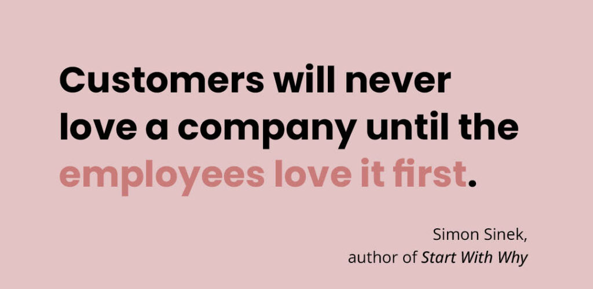
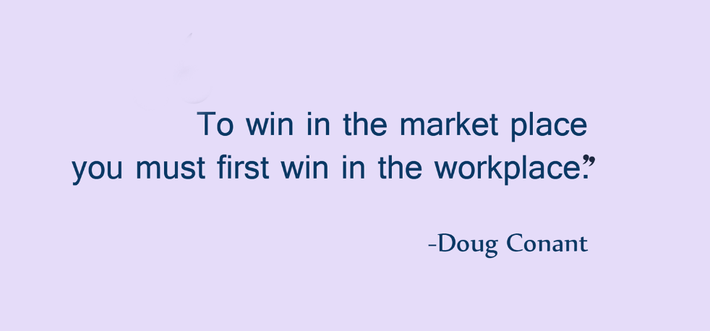
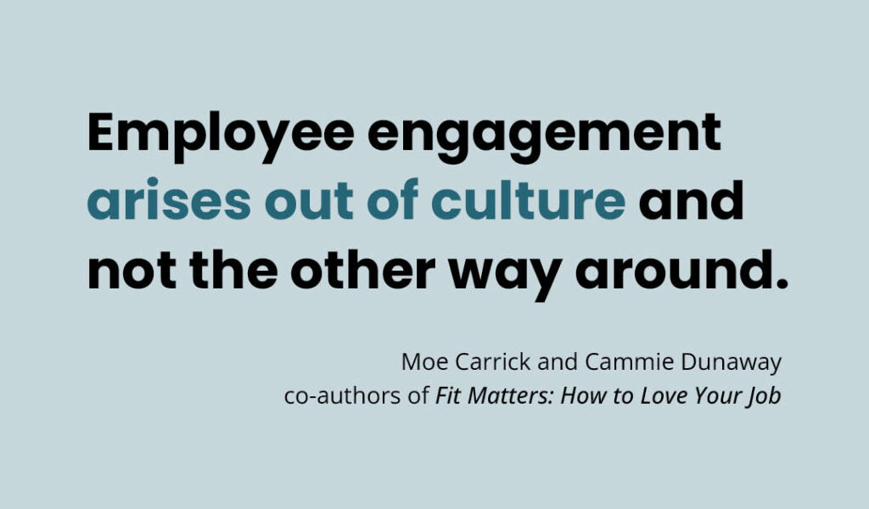

Slide 3

CULTURE

Slide 4


Work
The shared values, beliefs, and behaviors that shape workplace environment
Work Culture Matters
A positive work culture leads to higher job satisfaction and productivity

Slide 5
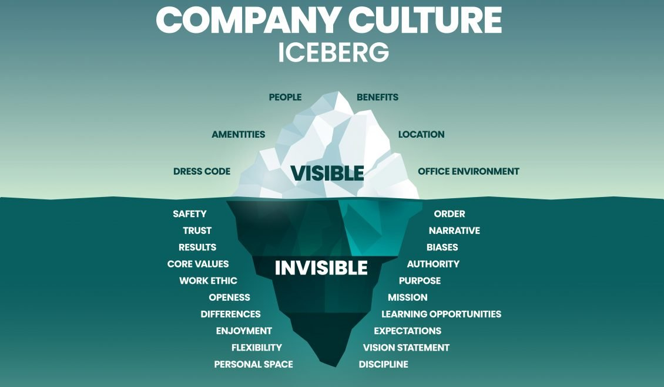

Slide 6

Core Elements of a Thriving Culture
Shared Vision & Values
The central guiding force for the team binding everyone together
Open Communication
The engine that powers collaboration
Recognition & Appreciation
Fueling motivation and pride
Work-Life Harmony
Balancing productivity with well-being
Inclusivity
A canvas for diverse ideas and perspectives

Slide 7

Shared
Vision

Slide 8
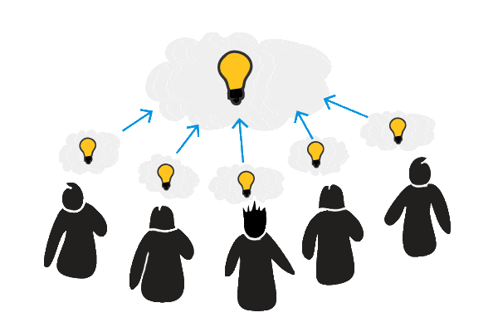
Shared Vision & Values
Understanding company’s mission and values helps work towards common goals
Organizational Mission
Make sure to know how your role contributes to company mission
Common Goals
Support teammates in achieving common objectives
Adaptability
Be open to change and adaptable to new
directions as the company’s vision

Slide 9











At
Our Mission
"At Immentia, we foster technology to make life simpler, easier and progressive around the globe!"
Our Values
Customer Relationship
Excellence
Ownership
Process Driven
Speed Matters
Learn and Develop
Think Big
Frugality
Exceptional Team
Social Responsibility

Slide 10

Open
Communication

Slide 11

Open Communication
The key to fostering a collaborative and innovative work environment
Speak Openly and Honestly
Share your thoughts and ideas openly. Your unique perspective is valuable, and expressing it helps us grow together. It also avoid/resolves any conflict
Give Constructive Feedback
Provide thoughtful feedback. It helps everyone do their best work
Listen Actively
Listen your colleagues attentively to build a
Supportive atmosphere to make everyone feel
valued

Slide 12
At
Scheduled meetings
T&D Support
Output Messenger
Outlook e-mail
Ticket Generation

Slide 13

Recognition
&
Appreciation

Slide 14

Recognition and Appreciation
Celebrating achievements, big or small, elevates spirits and strengthens teamwork
Shine Bright
Highlight and celebrate your achievements/victories. recognizing them boosts morale and motivation
High-Fives and Cheers
Create moments of recognition that uplift and energize teammates. A simple acknowledgment can inspire great things
Recognition Culture
Be proactive in appreciating your peers. Celebrating each other's successes fosters a positive and supportive environment for all of us

Slide 15
At
Positive Memo
Appreciation message
Bi-annual growth
Certificate
Overtime payment
Child education allowance

Slide 16

Work - Life
Harmony

Slide 17

Work-Life Harmony
Achieving work-life harmony ensures we stay energized, motivated, and productive
Flex Your Way
Customize your work schedule to fit your personal needs while staying aligned with team goals
Recharge Regularly
Prioritize regular breaks and time off to refresh and maintain high energy levels. Your well-being is crucial for long-term success
Maintain Balance
Effective workload management maintains balance between
work and personal life to keep your enthusiasm and
productivity high

Slide 18
At
Personal break
Gym Facility
Table tennis
Food Table serving

Slide 19

Inclusivity

Slide 20

Inclusivity
Making everyone feel valued to contribute leads to greater creativity and innovation
Celebrate Diversity
Appreciate and respect the different backgrounds, perspectives, and experiences each of your colleagues brings to the team. Everyone's unique viewpoint is valuable
Create Welcoming Space
Make sure that every team member feels welcomed and valued. Support each other by being inclusive and respectful, ensuring that everyone can fully participate
Work Together Effectively
Working together by considering various perspectives within your team fosters collaboration and innovation

Slide 21
At
Feedback form
Feedback e-mail
Portal Ticket
Portal “Report Annonymous” option

Slide 22
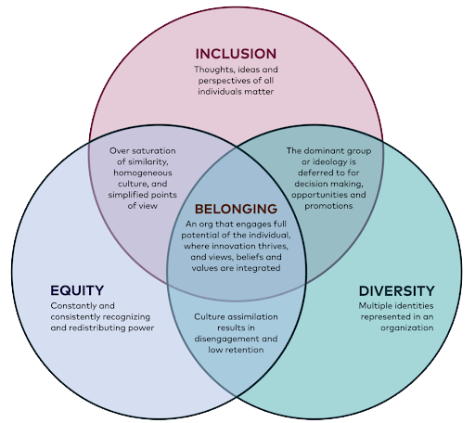

Slide 23

Open Forum

